Slide 1
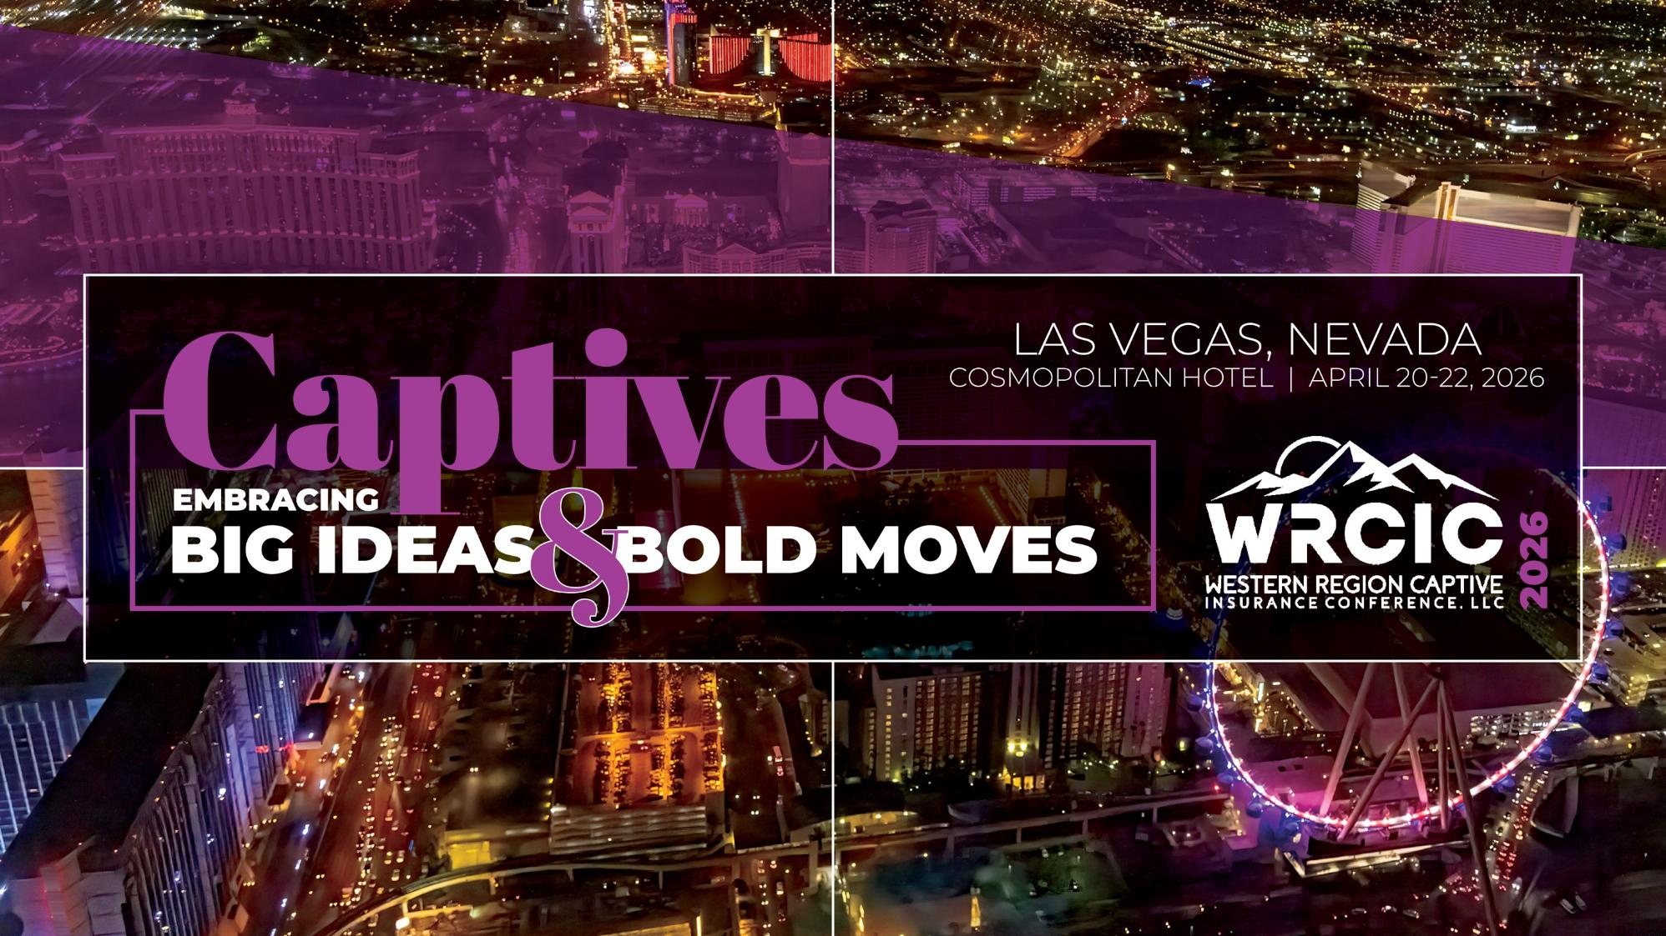

Slide 2

Best Practices for Captive Investments: Strategy & Innovation
21 April 2026

Slide 3

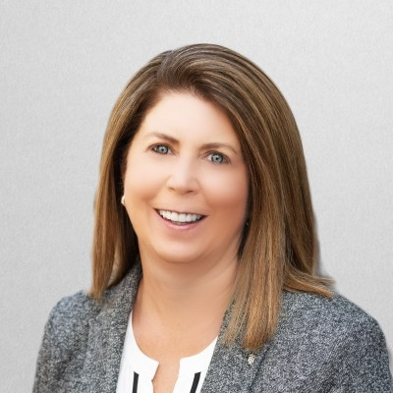
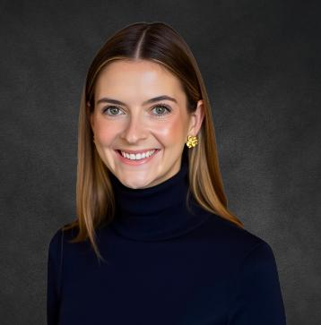
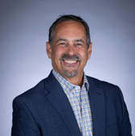
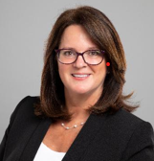
Your Speakers:
Suggested Revised Version
Click to add slide text
Anjanette Fowler
Managing Director
PNC
Madeline Jacobs, MBA, CPFA
Financial Planner
Jacobs & Coolidge
Jack Meskunas, MBA, ACI,
Managing Director-Investments
Oppenheimer & Co
Laura Phillips, CWS
SVP Wealth Advisor
Wilmington Trust
Click to add slide text

Slide 4
Captives in All Sizes and Types
Captives range widely in size, purpose, and regulatory oversight, including:
Pure captives
Series and segregated cell structures
RRGs and group captives
Onshore and offshore domiciles
Investment strategy is not one‑size‑fits‑all—structure and domicile materially influence portfolio construction, liquidity requirements, and permissible investments.

Slide 5
Generating Revenue From Risk
Control and leverage outside of commercial markets
Savings from premium payments
Investment income as a revenue source
Most captive conversations focus on tax structure, underwriting, and risk retention, but over time, the greatest driver of value within a captive can be the investment strategy.

Slide 6
A Client Centric Solution
Deep personalized analysis
Understand client’s goals and risk tolerance
Collectively determine IPS
Define and manage risk based on the client’s perspective
Continuously adapt as client needs evolve

Slide 7
Business Owner Case Study
Single parent captive
3 owners with different risk tolerances
Varying levels of financial acumen
Primary objective:
  Reduce risk
  Reduce expense
  Generate income
We help captive owners think through how to invest surplus capital prudently, so it compounds over time without compromising the captive’s primary mission.

Slide 8
Talking Domiciles—How Regulation Shapes Strategy
Domiciles range from principles‑based (“light touch”) to prescriptive (“heavy hand”) models.
Regulatory expectations may include:
  Informal guidance and “opinion‑based” oversight
  Formal asset concentration or duration limits
  Explicit liquidity or capital stress requirements
Domicile choice is a strategic decision that directly influences investment opportunity set, portfolio complexity, and innovation potential.

Slide 9
Governance As The Foundation
Effective captive investment programs are grounded in strong governance:
  Clearly defined investment policy statements (IPS) aligned with underwriting risk
  Explicit liquidity and capital preservation objectives
  Ongoing coordination among:
    Captive owners
    Boards and committees
    Advisors, managers, and custodians
Governance discipline enables flexibility without compromising regulatory or balance‑sheet integrity.

Slide 10
Captive Investment Policy Statement (IPS): Best Practices
Purpose: IPS establishes governance for captive assets; primary focus on claims‑paying ability through principal preservation and liquidity, with secondary objective of surplus growth.
Governance: Clearly defines roles of the board, advisor/manager, and custodian, including authority for allocation, rebalancing, and liquidity actions.
Regulatory Alignment: Reflects domicile statutes and regulatory expectations, ensuring defensibility across oversight environments.
Investment Framework: Aligns risk and liquidity with liability profile and surplus position; emphasizes liability‑aware portfolio construction over return maximization.
Oversight: Requires ongoing monitoring, stress testing, and periodic IPS review as the captive evolves.
Purpose: IPS establishes governance for captive assets; primary focus on claims‑paying ability through principal preservation and liquidity, with secondary objective of surplus growth. Governance: Clearly defines roles of the board, advisor/manager, and custodian, including authority for allocation, rebalancing, and liquidity actions. Regulatory Alignment: Reflects domicile statutes and regulatory expectations, ensuring defensibility across oversight environments. Investment Framework: Aligns risk and liquidity with liability profile and surplus position; emphasizes liability‑aware portfolio construction over return maximization. Oversight: Requires ongoing monitoring, stress testing, and periodic IPS review as the captive evolves.

Slide 11
Balancing Risk, Liquidity, and Return
Captive portfolios must balance:
  Claims‑paying liquidity
  Capital preservation
  Return objectives over the underwriting cycle
Best practices include:
  Segmenting assets by liquidity tier
  Matching duration to expected loss emergence
  Avoiding over‑reliance on static allocations
Flexibility and discipline are equally critical.

Slide 12
Macroeconomic Context: Navigating Volatility
Elevated volatility driven by:
  Inflation dynamics and interest rate uncertainty
  Geopolitical risk
  Shifts in productivity and technology (including AI)
Implications for captives:
  Greater importance of staying invested
  Re‑evaluation of active vs. passive approaches
  Size and Direction of Interest Rates—What does the Dot Plot tell us?

Slide 13
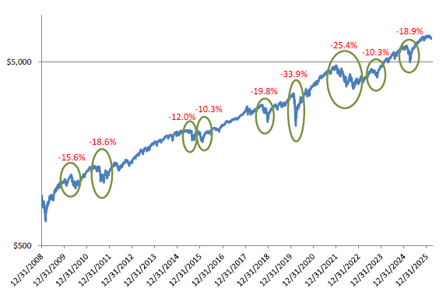
Climbing the “Wall of Worry”

Slide 14
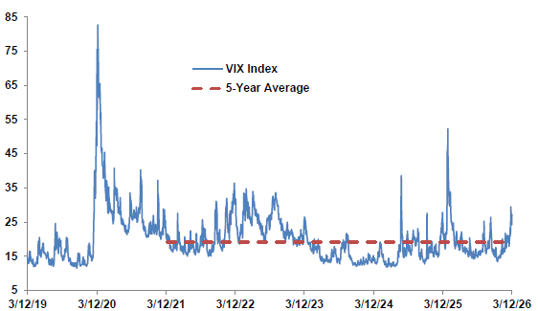
The “Fear Index”—Yes, there is such a thing

Slide 15
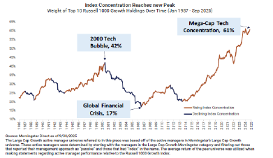
Periods of Rising and Falling “Concentration”

Slide 16
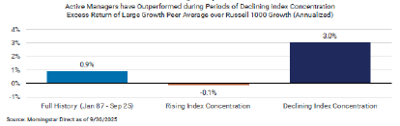
Index Overconcentration Increases Volatility—In the “Long Run” Active Beats Passive Investing

Slide 17
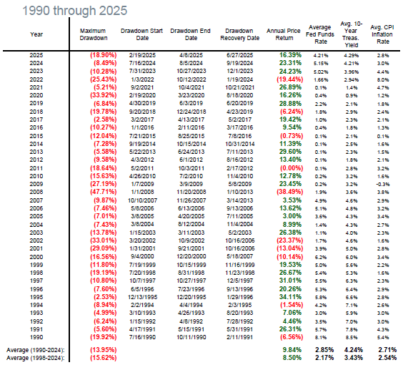
Maximum Annual Drawdowns 1990-2025
Source FactSet, used with permission

Slide 18
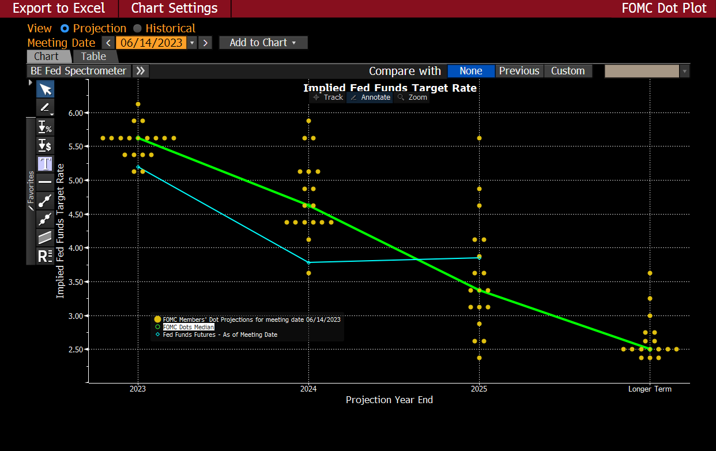
Fed Dot Plot September 2023: Peak Rates

Slide 19
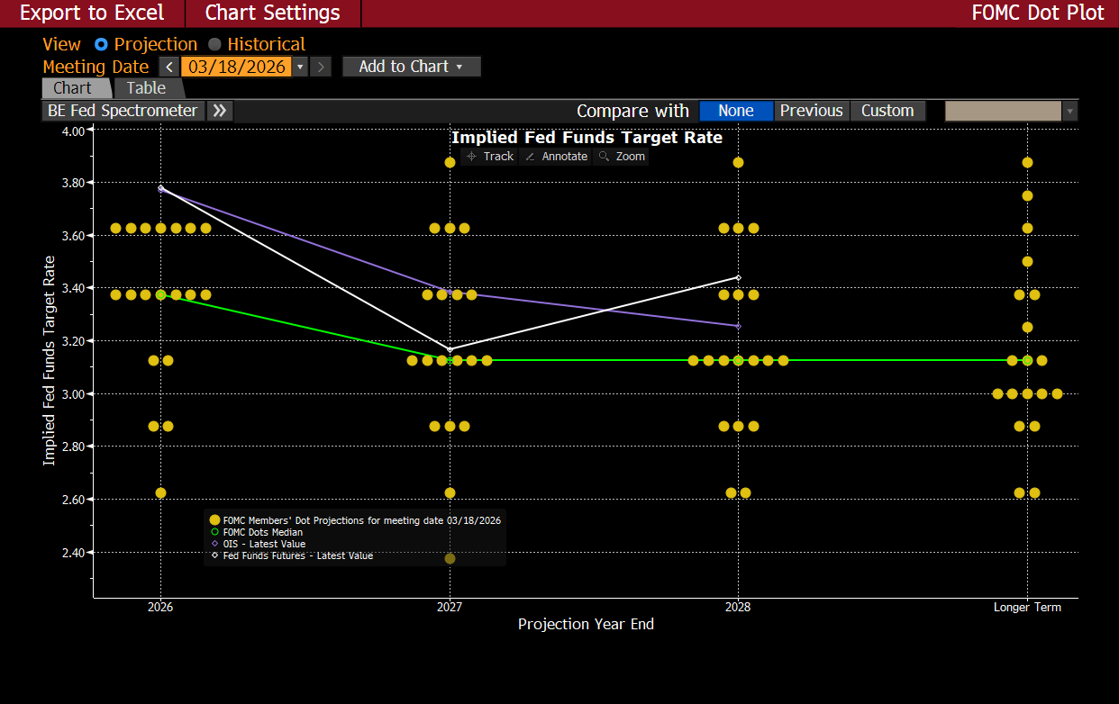
Federal Reserve Dot Plot: March 2026

Slide 20
Innovation in Captive ALM
Captives are increasingly exploring innovative ALM solutions, including:
  Custom structured products
  Defined‑outcome strategies
  Tools designed to reduce correlations to equity
  or rate volatility
Innovation works best when:
  Aligned with liability profiles
  Appropriately sized within the overall portfolio
Innovation should enhance—not replace—core investment discipline.

Slide 21
Key Takeaways for Captive Stakeholders
Investment strategy must be purpose‑built around captive structure, domicile, and liabilities.
Strong governance enables flexibility, resilience, and opportunity.
Liquidity and capital preservation remain paramount—even in search of yield.
Thoughtful innovation can add value when aligned with risk management objectives.

Slide 22

Contact Information:
Laura Phillips: lphillips4@wilmingtontrust.com
Jack Meskunas: jack.meskunas@opco.com
Madeline Jacobs: madeline@jacobsandcoolidge.com
Anjanette Fowler: anjanette.fowler@pnc.com

Slide 23
