Slide 1


Slide 2
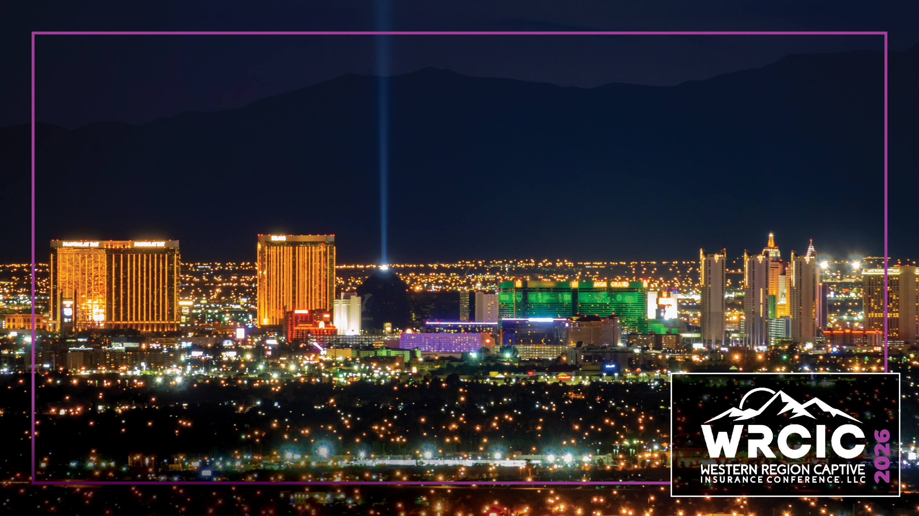
Amplify Women: Bridging the Gap
Melissa Hollingworth, LAUSD
Andrea Monterotti , Milliman
Lauren Thomas, CICA
Grace Topete, Helio Risk
Notes:
Introductions

Slide 3

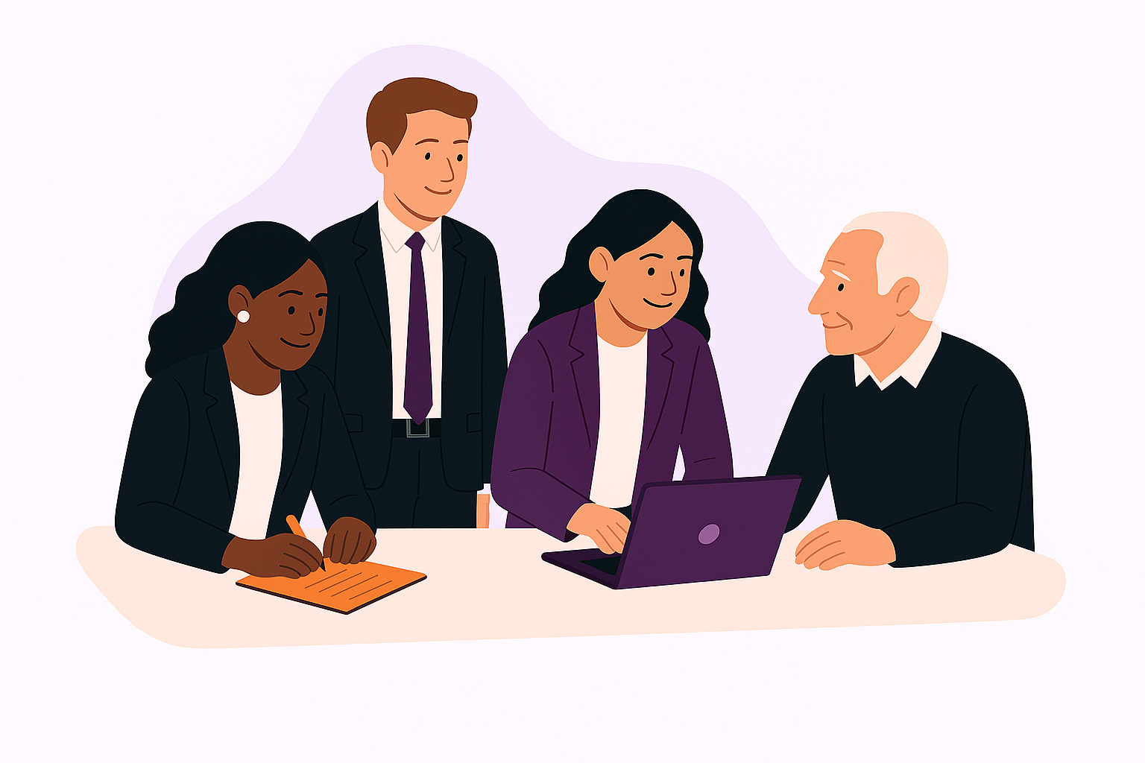
Generational Differences in the Workplace
Key generational perspectives
Ways to close the gap to connect and collaborate
Leadership and career progression
Notes:
Grace gives overview of what’s going to be covered with 3 main points:
Begin with key differences:
Melissa: Communication styles: phone calls or emails vs. quick texts or teams messages
Lauren: Younger generations thrive on peer to peer / 1 on 1 meetings; older generations are used to annual review
Andrea: Flexibility in younger generations vs. loyalty in seasoned generations
-

Slide 4
Creating Inclusive Environments
Implement flexible work policies
Intergenerational mentor program
Create opportunities for collaboration
Celebrate diversity and inclusion
Provide professional development opportunities
Lead by example
Notes:
Grace poses question about flexible work policies and opportunities to collaborate
Lauren can give examples of what we do on Monday meetings and getting to know each other
Andrea gives experiences with professional development opportunities or mentorship
Melissa closes it out with leading by example and what she’s done with her staff

Slide 5
Mentoring & Coaching throughout Career Stages
Knowledge Transfer
Skill Development
Career Advancement
Increased Engagement and Retention
Enhanced Diversity and Inclusion
Succession Planning
Notes:
Grace hits a few high points on different phases in career and asks question about experiences by each panelist –address talent crisis and employers need to adapt

Slide 6

Learn more and get involved!
Notes:
Melissa speaks to ways to get involved and her experiences

Slide 7
Amplify Women: Bridging the Gap
Questions?

Slide 8
