Slide 1


Slide 2

831(b) Update
F. Hale Stewart
Melissa Wiley
Sol Feinberg

Slide 3

Current Status of Challenges to 831(b) Reporting Regulations
Eastern District of Tennessee ruled for the government on summary judgement
Northern Texas: The final rule did not exceed the government’s authority but the plaintiff adequately alleged that the final regulations based on the 30% loss ratio were “arbitrary and capricious.”
  Litigation is ongoing.

Slide 4
Drake Was Successful
The court ruled the agency was within its power in determining a transaction of interest.
The court ruled that the Listed Transaction was beyond the agency’s power.

Slide 5
General Rules on Reporting
The US has a self-reporting tax system, which means taxpayers submit information to the IRS.
Because we use a self-reporting system, the IRS has broad authority to determine what transactions are reportable and mandate disclosure.
Taxpayers that participate in a “reportable” transaction must disclose additional information to the Treasury.

Slide 6
Reportable Transactions
A transaction of interest is a transaction that is the same as or substantially similar to one of the types of transactions that the IRS has identified …. as a transaction of interest.
  We think it’s a tax shelter
  Not filing = Up to $50,000 fine
A listed transaction is a transaction that is the same as or substantially similar to one of the types of transactions that the Internal Revenue Service (IRS) has determined to be a tax avoidance transaction
  It is a tax shelter.
  Not filing = Up to $200,000 fine

Slide 7
Form 8886
All material elements of the transaction are disclosed, including all the advisers who received a fee.
This information is attached to the tax return
It is sent to OTSA – Office of Tax Shelter Analysis
The information is organized and analyzed to find the biggest fish is the pond
These fish are then targeted.

Slide 8
831(b) Transaction of Interest
At least 20% of the captive is owned, directly or indirectly, by the insured
Either
  The captive makes assets available to the parent company in a manner that does not result in taxable income or gain to the parent, OR
  The captive has a loss ratio of less than 60% over the most recent 10-year period.

Slide 9
831(b) Listed Transaction
At least 20% owned by insured/parent company
The captive made financing available in the last 5 years that did not result in reportable income, and
That captive had a loss ratio less than 30% for the last 10 years.

Slide 10
This Isn’t Close to Over
The treasury has disliked captives since the mid-1950s
In 1977 the Treasury argued any fronted program – regardless of the flow of funds – was invalid.
  This was revoked in the early 2000s
As recently as the last 15 years, they have argued that a 200,000-employee fronted WC program was not a legitimate insurance company (Securitas).
  Also consider the facts of RAC and RVI.
The microcaptive cases have provided the government with a wealth of helpful legal arguments.
  There is now sufficient case law for the Treasury to challenge in good faith any captive transaction (pure and group), save for the 100 largest pure captives.
  This does not mean the government will win.
  But with the possibility of a challenge, taxpayers must contend with the fact that they will have to spend several millions of dollars to defend their program in tax court.

Slide 11
A Profound Note of Caution on Claims
From CIC Services v. IRS
  Pricing premiums far in excess of what is reasonably needed to fund insurance operations results in a lower loss ratio and remains a strong indicator of tax avoidance. Further, while amounts paid for insurance may be deductible business expenses, amounts set aside in a loss reserve as a form of self-insurance are not.
In Drake, low claims are a problem.
  If an insurance provider has a lower-than-average modified loss ratio, that provider is likely earning unreasonable profits
  Underwriting profits “in the commercial insurance market have typically been in the 5% to 6% range.”
  The agency reasonably sought information about insurance transactions resulting in unusual profit margins, which may suggest that taxable revenue is being diverted into unnecessary insurance premiums.

Slide 12
A Profound Note of Caution on Claims
BUT, the Ryan court determined the IRS was “arbitrary and capricious” in how it determined the claims rate. Here, the court ruled that the taxpayer successfully pleaded a case and that the government had not sufficiently explained why it settled on the 30% loss ratio.
  There the IRS relied exclusively on the facts from RVI, which had several years of few, if any, losses, and others with large losses.

Slide 13
Where Does This End?
From Drake
“The administrative record includes recent multiple tax court decisions in which courts determined that a taxpayer in a micro-captive transaction remitted amounts treated as insurance premiums for something other than insurance.” These rulings “provide the ‘facts and data’ necessary for the Treasury Department and the IRS to conclude that captive insurance arrangements are potentially used for tax avoidance” and “a legitimate basis for the Treasury Department and the IRS to seek additional information from captives and material advisors to aid in determining whether a captive is, in fact, impermissibly avoiding tax liability.”
Reporting will be upheld. The audits will continue.

Slide 14
831(b) Part II Economic Substance
Melissa
April 20-22, 2026

Slide 15
Economic Substance Doctrine – Overview
The economic substance doctrine is a judicially created rule that disallows tax benefits from transactions that lack both:
  Objective economic substance – a real economic effect aside from tax benefits, AND
  Subjective business purpose – a genuine non-tax profit objective

Slide 16
Objective Economic Substance
A transaction has objective economic substance if:
  It produces a meaningful change in taxpayer’s economic position (aside from tax effects), and
  There is a reasonable possibility of a profit independent of tax benefits

Slide 17
Key Objective Economic Substance Cases
Gregory v. Helvering, 293 U.S. 465 (1935)
  Held that a corporate reorganization lacked substance because it had no business purpose aside from tax savings
  Established the principle that form must reflect substance to justify tax outcomes
Knetsch v. United States, 364 U.S. 361 (1960)
  Disallowed interest deductions because the transaction at issue had no real economic risk or business purpose
  Held that economic reality – not just form – drives tax consequences
Frank Lyon Co. v. United States, 435 U.S. 561 (1978)
  Recognized tax treatment of a leveraged lease because the transaction had genuine economic consequences, risks, and rewards
  Distinguished from sham transactions
ACM Partnership v. Commissioner, 157 F.3d 231 (3d Cir. 1998)
  Transaction lacked economic substance because deductions far exceeded realistic pre-tax profit
  Deals viewed as tax shelters rather than real investments

Slide 18
Subjective Economic Substance
A transaction has subjective economic substance if the taxpayer’s primary purpose is:
  A bona fide business purpose, and
  Not solely to reduce taxes

Slide 19
Key Subjective Economic Substance Cases
Gregory v. Helvering, 293 U.S. 465 (1935)
  Also foundational in assessing taxpayer’s intent
  Steps taken must serve a business purpose, not merely tax avoidance
Bolker v. Commissioner, 760 F.2d 1039 (9th Cir. 1985)
  Held that stated business purpose was credible, even though tax benefits were substantial
  Intent of the taxpayer matters

Slide 20
Codification of Economic Substance
In 2010, Congress enacted Internal Revenue Code § 7701(o) mandating that courts consider both:
  Objective economic substance, and
  Subjective business purpose
Explicitly codified the two-prong test used by many courts
If a transaction lacks either, tax benefits are disallowed

Slide 21
7701(o) Clarification of economic substance doctrine
(1) Application of doctrine In the case of any transaction to which the economic substance doctrine is relevant, such transaction shall be treated as having economic substance only if—
  (A) the transaction changes in a meaningful way (apart from Federal income tax effects) the taxpayer’s economic position, and
  (B) the taxpayer has a substantial purpose (apart from Federal income tax effects) for entering into such transaction.

Slide 22
7701(o) Clarification of economic substance doctrine
(2) Special rule where taxpayer relies on profit potential
In general The potential for profit of a transaction shall be taken into account … only if the present value of the reasonably expected pre-tax profit from the transaction is substantial in relation to the present value of the expected net tax benefits that would be allowed if the transaction were respected.
…
(4) Financial accounting benefits
… achieving a financial accounting benefit shall not be taken into account as a purpose for entering into a transaction if the origin of such financial accounting benefit is a reduction of Federal income tax.

Slide 23
7701(o) Clarification of economic substance doctrine
(5) Definitions and special rules For purposes of this subsection—
(A) Economic substance doctrine
The term “economic substance doctrine” means the common law doctrine under which tax benefits … with respect to a transaction are not allowable if the transaction does not have economic substance or lacks a business purpose.
…
(C) Determination of application of doctrine not affected
The determination of whether the economic substance doctrine is relevant to a transaction shall be made in the same manner as if this subsection had never been enacted.

Slide 24
Liberty Global, Inc. v. United States, 1:20-cv-03501-RBJ (D. Colo. Oct. 31, 2023)
Facts & Context
In Liberty Global, the IRS used the economic substance doctrine to deny claimed tax positions arising from complex corporate transactions.
The district court accepted the IRS’s analysis that the doctrine applied broadly, even absent a distinct threshold determination of relevance, and disallowed tax benefits on that basis.
Relevance Requirement
The taxpayer appealed, arguing that the economic substance doctrine should only apply where the statute makes relevance clear, and that taxpayers should not face the doctrine in transactions where economic reality and motive are not genuinely at issue.
Significance
This case demonstrates a judicial split over how expansively the codified doctrine should be applied, i.e., whether relevance is a distinct threshold or assumed whenever tax benefits exist.

Slide 25
Patel v. Commissioner, 165 T.C. 10 (2025)
Objective Economic Substance
The court held the transactions did not meaningfully change the taxpayers’ economic position apart from federal income tax effects, because the transactions involved circular flows of funds and no real economic risk distribution beyond conventional commercial insurance.
Subjective Business Purpose
Even though failing the objective prong was sufficient, the court also concluded the taxpayers lacked a substantial non-tax business purpose for entering into the captive arrangement at issue.
Relevance Requirement
After requesting amicus briefs on the issue, the court held that a relevancy determination was required before applying the two-prong § 7701(o) test.

Slide 27
Law of Large Numbers:
A Coin Flipping Illustration
Sol Feinberg, FCAS, MAAA
4/21/26

Slide 28
Sol Feinberg, FCAS, MAAA
Consulting Actuary with SIGMA Actuarial Consulting Group, Inc. since 2020
Actuary for a monoline WC carrier
Actuary for the NV DOI
Masters in Physics from University of Illinois

Slide 29
n = the number of flips
X = the number of Heads

Slide 31
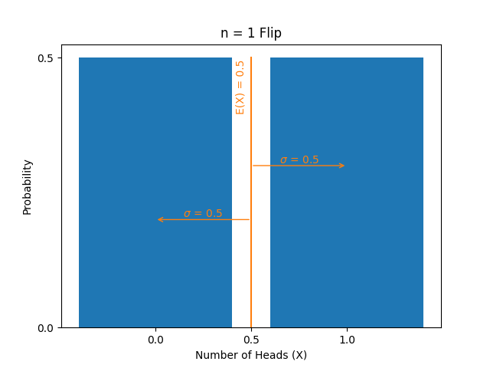

Slide 32
E(X) = is the average or expected value of X
Var(X) = σ^2 = the average or expected value of [X - E(X)]^2
SD(X) = σ

Slide 33
If we look at n = 2 independent flips:
  How many heads do we expect?
  What do we expect the variance and standard deviation to be?

Slide 35
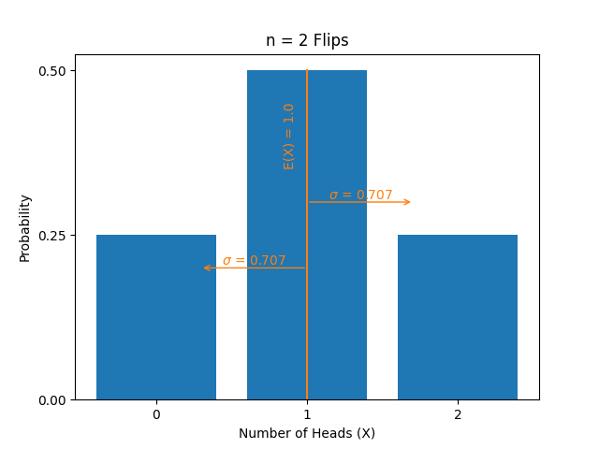

Slide 36
For n = 2 flips:
  E(X) = 1
  Var(X) = σ^2 = 0.5
  SD(X) = σ = sqrt(0.5) = 0.707

Slide 37
In General, for n flips:
  E(X) = n * 0.5
  The expected value of a sum of independent random variables is the sum of their individual expected values.
  Var(X) = σ^2 = n * 0.25
  The variance of a sum of independent random variables is the sum of their individual variances.
  SD(X) = σ = sqrt(n) * 0.5

Slide 39
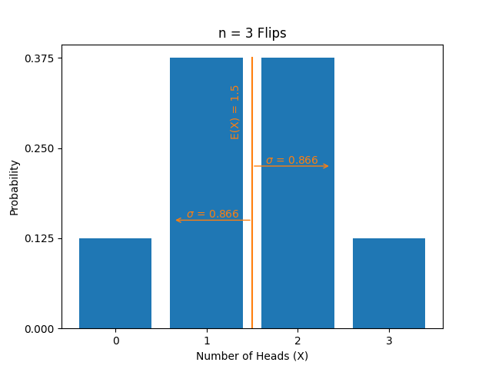

Slide 40
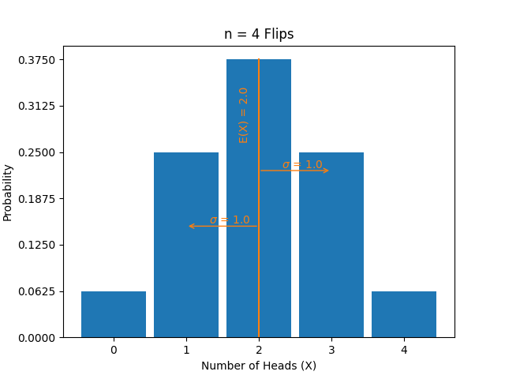

Slide 41
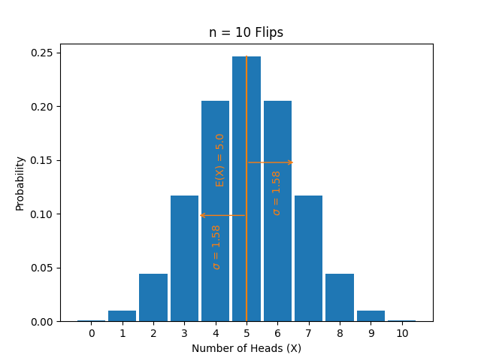

Slide 42
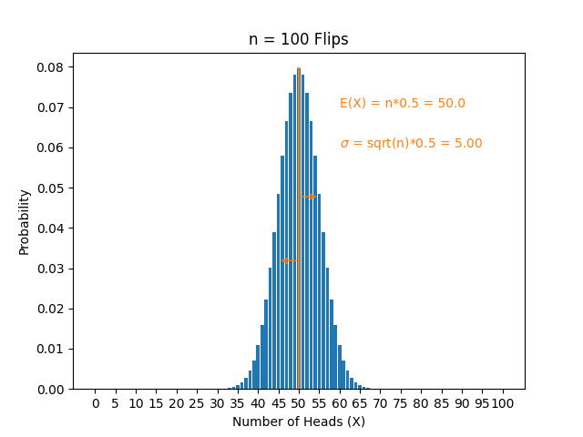

Slide 44
What would we see if, instead of looking at the total number of heads (X), we looked at the total number of heads divided by the number of flips (X/n)? Or the average number of heads per flip?

Slide 46
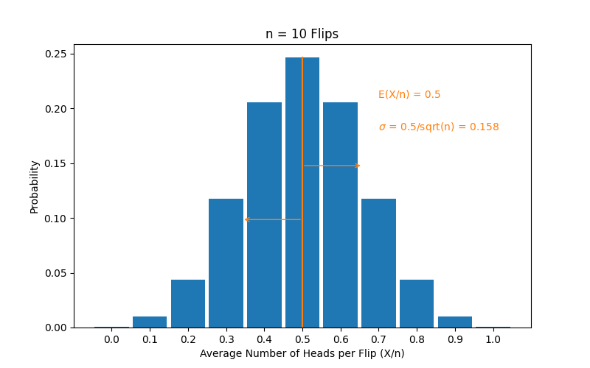

Slide 47
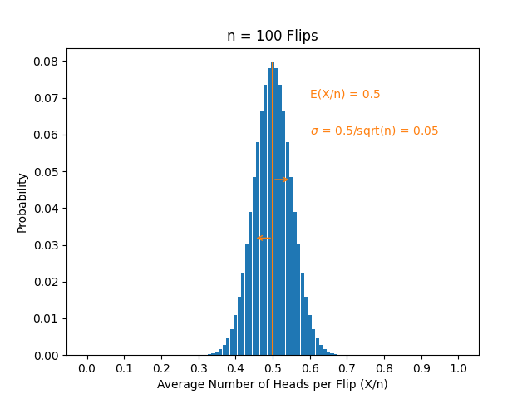

Slide 48
The sum of n independent identically distributed random variables (X) becomes normally distributed as n increases sufficiently.
Likewise, the average of n independent identically distributed random variables (X/n) becomes normally distributed as n increases sufficiently.
For a normal distribution, there is a
68.3% chance of being within one SD of the mean
95.4% chance of being within two
99.7% chance of being within three

Slide 49
Example of normal approximation:
For n = 100 flips, E(X) = 50, and SD(X) = 5. Therefore, there is a:
  68.3% probability that X will be between 45 and 55
  95.4% probability that X will be between 40 and 60
  99.7% probability that X will be between 35 and 65.
Likewise, the average number heads (X/n), for the n = 100 flips, has E(X/n) = 0.5, and SD(X/n) = 0.5/sqrt(n) = 0.05. Therefore, there is a:
  68.3% probability that X/n will be between 0.45 and 0.55, etc.

Slide 50
LLN Summarized:
Given an arbitrary underlying distribution with expected value μ and standard deviation σ. If we take n independent samples from the underlying distribution, add the results to get the sum X, and divide by the number of samples to get the average (X/n), we have:
E(X/n) = μ
SD(X/n) = σ/sqrt(n)
The process risk, or inherent uncertainty of the results for a single coin flip, say, can be diversified away, and we can be very certain of the results for larger numbers of flips.
Furthermore, X/n approaches a normal distribution as n increases.

Slide 51
LLN applies when:
We know the parameters of the underlying distribution.
Successive samples from the distribution are independent.

Slide 52
Conditions for LLN are well satisfied for a casino offering slot machines.
The possible payouts for a single pull and their associated probabilities are chosen by the game designers and the casino owners.
These result in:
  A certain expected payout percentage (as a percent of the amount bet), e.g., 94%.
  A certain standard deviation in the payout percentage, for a single pull, e.g., 1000%.
  The results of successive pulls are independent.
The inherent uncertainty of the results from a single pull can be diversified away, with a large number of pulls, and the casino can be very certain of its results.

Slide 53
Moral differences aside, a casino is not entirely like an insurance company:
1.) The parameters underlying (our model of) the insurance process are not known.
2.) Losses under different policies may not be (fully) independent.

Slide 54
Expected losses during a prospective occurrence period are estimated based on past losses during an historical occurrence experience period.
Actual losses during the experience period are subject to process risk. (Maybe we observed heads 0.48 percent of the time rather than 0.50)
Actual losses during the experience period generally are not known. Actuaries may still be applying LDFs to estimate the ultimate cost of claims from the experience period (when all claims are closed).
Adjusting historical experience to the prospective period usually requires applying some trend, which is subject to mis-estimation.

Slide 55
Losses under different policies may be correlated to some degree.
For property coverages, the occurrence of a NWS may cause losses on many policies simultaneously, resulting in strong correlation.
Losses on different policies may be affected by a change in the legal environment.

Slide 56
We might be estimating an underlying loss potential of $50 per risk, when the true underlying loss potential might be $60.
This is akin to the old adage about buying eggs at 10¢ a piece, selling them for $1 a dozen, and making up the difference on volume.
If an insurance company underestimates the rate needed for a given class of insureds, writing more of them will not ameliorate the issue, rather it will exacerbate it proportionally.

Slide 57
Modeling aggregate losses as a composite process - where the number of claims is a random variable with a given expected value, and the severity of each claim is independent and has a certain expected value and standard deviation - is a common practice.
Actuaries commonly do this to estimate the aggregate loss distribution during a prospective period. This helps see how aggregate losses may vary around their expected value.
This process is subject to the same limitations discussed for the law of large numbers: The values of associated parameters may not be known (exactly), and different claims may not be (completely) independent.

Slide 58
Insurance regulators and actuaries are not (typically) asking the question of whether there are a sufficient number of insureds to achieve risk distribution, under the theory that all process risk will be sufficiently diversified away at that point (while ignoring parameter risk).
Rather, insurance regulators and actuaries are concerned with premium rates, reserve levels, and supporting capital or surplus being adequate to reasonably ensure the functioning of the insurance system.

Slide 59
CAS Statement of Principles Regarding Property and Casualty Insurance Ratemaking:
A rate is an estimate of the expected value of future costs. Ratemaking should provide for all costs so that the insurance system is financially sound.
A rate is reasonable and not excessive, inadequate, or unfairly discriminatory if it is an actuarially sound estimate of the expected value of all future costs associated with an individual risk transfer.

Slide 60
NAIC Model Laws echo the CAS language (or vice versa):
Rates are inadequate if they are clearly insufficient, together with the income from investments attributable to them, to sustain projected losses in the class of business to which they apply. NRS 686B.050.

Slide 61
The main paper I’m familiar with in demonstrating risk distribution is the excellent article by Pinnacle on EAD or Expected Adverse Deviation.
Solvency modeling might offer a basis for another approach:
Looking at rate levels, reserves, and capital and surplus required to ensure solvency at a given confidence level
While considering the number of risks, associated process risk, and parameter risk.

