Slide 1


Slide 2

Is this Insurance? And what if it isn’t?
Chaz Lavelle, Dentons
Robert Walling, Pinnacle
Diana Hardy, RH CPAs
April 22, 2026

Slide 3

Setting the Stage
The Current Environment
Case Killers
What this session is (and is not)
Notes:
10 minutes

Slide 4

Insurable Risk
What Makes a Risk Insurable?
  Fortuity
  Measurability
  No intentional acts
  Limited moral and morale hazard
Notes:
5 minutes on Insurable risk

Slide 5
Insurable Risk
No formal definition – only boundaries
  Neither the Tax Court nor the IRS has defined “insurance risk”
  Instead, they distinguish it from: speculative or investment risk and business risk
  IRS acknowledges a difference between business risk and insurance risk but provides no bright-line tests
    Imbedded warranty v. extended warranty
    Currency fluctuation (before and after the RVI Guaranty case)
Notes:
5 minutes on Insurable risk

Slide 6

Insurable Risk
Common questions:
  Is this a standard industry coverage or coverage form?
  Are both timing and economic risk transferred?
  Are claims values estimable?
  Are there obvious moral or morale hazards?
  Is the exposure predominantly insurance or business risk?
Notes:
5 minutes on Insurable risk

Slide 7

Risk Shifting/Risk Transfer
Looks at the arrangement from the perspective of the insured (ie – a risk faced by the insured has been transferred)
Must involve shifting of risk (timing and amount)
Did the contract shift a real risk that the enterprise faced?
Must involve significant change of a material economic loss
Notes:
5 – 7 minutes = risk shifting/risk transfer

Slide 8
Risk Shifting/Risk Transfer
Why this is usually not the hill to die on
  Often conceded in litigation
  Key issues arise mainly in complex reinsurance
  Accounting standards differs from tax doctrines
Notes:
5 – 7 minutes = risk shifting/risk transfer

Slide 9
Risk Shifting/Risk Transfer
Why ERD Comes Up
  Expected Reinsurer Deficit = Freq (Reinsurer Loss) x Average Severity (Reinsurer Loss)
  1% is the commonly accepted threshold – derived from “10-10” rule
  No “bright-line” indicator
  More robust than “10-10 rule”
  Requires cash flow analysis
Notes:
5 – 7 minutes = risk shifting/risk transfer

Slide 10
Risk Distribution
The Real Battleground
Most captive failures die here
Courts focus on substance over form
Distribution must exist in fact, not just on paper
Notes:
10 minutes = Risk Distribution

Slide 11
Risk Distribution
Distribution Signals for the Courts
  Number of insureds/exposures
  Independence of risks
  Absence of circularity
  No single insured dominance
  Practical Considerations
    Policy limits & deductibles
    Coverage triggers
    Narrowing covered causes of losses
    Excluding routine business volatility
Notes:
10 minutes = Risk Distribution

Slide 12

Common Notions of Insurance
Behavior Matters
  Underwriting discipline
  Timely policy issuance
  Claims handling consistency
  Arm’s-length behavior
Notes:
5 – 7 minutes = common notions of insurance

Slide 13

Common Notions of Insurance
Red Flags in Practice
  Eating claims instead of filing
  Sloppy or nonexistent claim files
  Investment strategies inconsistent with insurance
  Casual governance
Notes:
5 – 7 minutes = common notions of insurance

Slide 14

What If It’s NOT Insurance (or Not Enough)?
Warning Signs
  Too Many “Fixable” Issues Stacked Together
    Each issue may be defensible alone
    Multiple weaknesses compound and undermine substance
  Reliance on Explanations Instead of Evidence
    “Commercially reasonable” must be demonstrable
    Verbal intent ≠ actuarial, contractual, or claims evidence
    Courts and IRS focus on what happened, not what was intended
  Excessive Deviation from Industry Norms
    Unusual limits, triggers, or exclusions require strong support
    Premiums, retentions, or coverages far outside market benchmarks raise questions
Notes:
15 minutes – what if it’s not insurance

Slide 15
What If It’s NOT Insurance (or Not Enough)?
Tax Consequences
  Two IRS Revenue Rulings where there is not risk distribution
    Capital contribution
    Loan
    Deposit
    Indemnification Payment
  Two Tax Court Cases
    No deduction to the insured
    Income to the Captive
Notes:
15 minutes – what if it’s not insurance

Slide 16
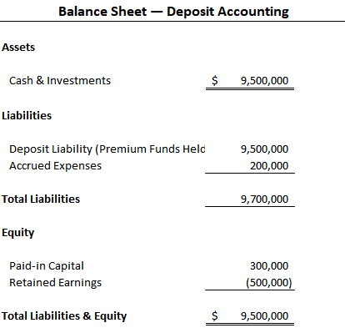
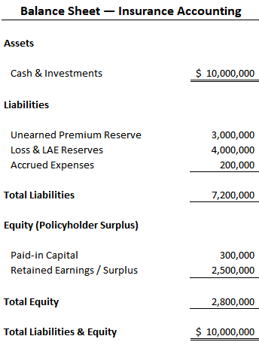
What If It’s NOT Insurance (or Not Enough)?
Accounting Consequences Matter
Notes:
15 minutes – what if it’s not insurance

Slide 17
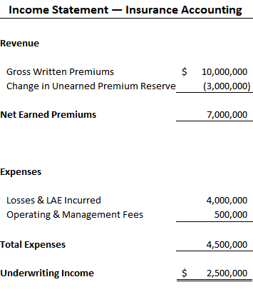
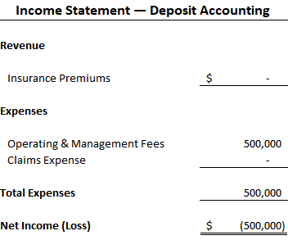
What If It’s NOT Insurance (or Not Enough)?
Accounting Consequences Matter
Notes:
15 minutes – what if it’s not insurance

Slide 18
What If It’s NOT Insurance (or Not Enough)?
How to Make it More Insurable
No surprises – who needs to know and when?
Notes:
15 minutes – what if it’s not insurance

Slide 19
What If It’s NOT Insurance (or Not Enough)?
Final Takeaways
Courts punish patterns, not just mistakes
Most issues are fixable, before binding
Documentation, behavior, and design must align
It it’s not insurance, understand the consequences early
Notes:
15 minutes – what if it’s not insurance

Slide 20


