Slide 1


Slide 2

ADVOCACY MATTERS
April 21, 2026

Slide 3

PANEL
Sandy Bigglestone, Strategic Risk Solutions
Joe Deems, National Risk Retention Association
Kevin Doherty, Dickinson Wright PLLC
Rep. Sean Tarwater, Kansas House of Representatives

Slide 4
Government Structure
Three Branches of Government (at both state and federal levels)
  Legislative (Congress or General Assembly)
  Executive (President or Governor or state or federal agencies)
  Judicial
McCarran-Ferguson Act (1945)
National Association of Insurance Commissioners (NAIC)
National Conference of Insurance Legislators (NCOIL)
Federal Insurance Office (FIO) (2010 Dodd Frank)

Slide 5
Building Relationships with Key Players
Identify the right state and national officials
  Benefit of maintaining relationships with elected representatives, including members of state legislature, members of Congress, other elected officials, and regulators
  Start with your home state
  This is not politics, it is business
Reach out and build relationships
  Attend events and fundraisers
  Make yourself known to the people who can have an impact on captives
  Better to do this early in order to be prepared for a crisis

Slide 6
Building Relationships with Key Players
Know the regulators in your home domicile
  Also get to know other regulators where you do business
  Often issues can be resolved without legislative action by working with regulators
Work with lobbyists
  State vs. federal
  Understand difference between what either can do
Work with other government officials
  Governor’s offices and state tax officials
  IRS

Slide 7
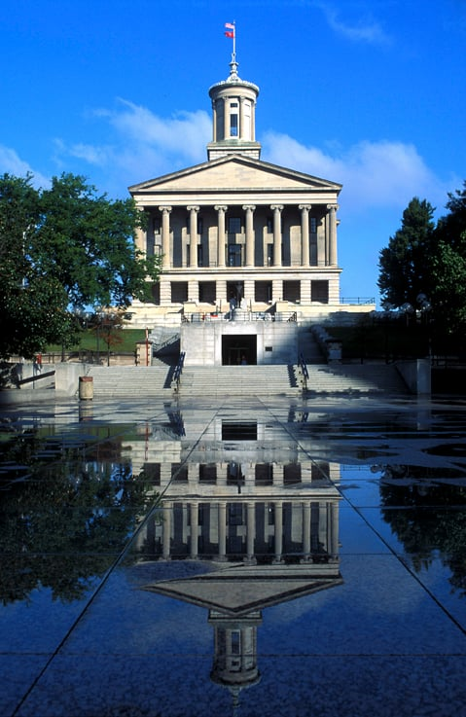
Advocating for Good Captive Legislation
Educate on the importance and unique nature of captives
Craft good legislation
Maximize chances of success
Understand the political ramifications
  Captives are usually non-partisan, but it is important to understand the players involved (State legislators vs. regulators, executive branch vs. legislative branch, Governors and political parties, and elected vs. appointed insurance commissioners)

Slide 8

Case Studies in Advocacy

Slide 9
Case Studies in Advocacy
Vermont as the “gold standard” (1981)
Nevada (1999)
South Carolina (2000)
Utah (2003)
Missouri (2007)
Tennessee (2011)
Oklahoma (2023)
Kansas (2025)

Slide 10
Questions and further discussions
Q&A

Slide 11
