Slide 1


Slide 2

Jerry Faiella, Joe Streck, and Eryn Brasovan
April 21, 2026

Slide 3

Presenters
Jerry Faiella: MEBCORP, Executive Director
Joe Streck: Innovative Captive Strategies, AVP – Consulting and Management
Eryn Brasovan: Womble Bond Dickinson, Partner

Slide 4
Benefits of Risk Transfer through Captive Insurance
Save money over time – You keep profits if claims are low instead of paying
everything to insurers and can earn investment income on your own reserves
Customize your coverage – Insure exactly what you need, even unusual
risks
Improved risk management – Encourages safer operations and fewer
losses
Access cheaper reinsurance – Buy coverage at lower, wholesale-type rates
More stability – Less exposure to rising insurance market prices

Slide 5
Benefits to Municipalities of Risk Transfer through Captive Insurance
The same general benefits plus…
  Stabilizing cash flow by smoothing premium pricing volatility
  More transparency into pricing decisions and claim handling
  Responding quickly to evolving risks
  Greater control of decision-making

Slide 6
Municipal Captive: Hurdles & Roadblocks
Substantial startup costs and initial funding – Feasibility study; hiring
service providers; collateral deposit
Ongoing costs – Ongoing costs include annual domicile fees, captive
management fees, D & O insurance costs and annual actuarial and audit
fees
Layers of stakeholders – Municipal leadership; elected officials; taxpayers
Time required to achieve cost savings and potential profit
Low risk tolerance level

Slide 7
Municipal Captives: How to Succeed
Communication – Messaging the right benefits to the right audience
Consideration – Working with experienced service providers who
understand your objectives
Costs – Focus on the long-term savings
Control – More control → more predictability → reliable outcomes
Commitment – Commit to obtaining buy-in and commit to producing results

Slide 8

MEBCO: A Success Story!
Consortium/Group of NY state governmental entities (Section 115 IRC):
  7 Municipalities
  2 School Districts
Formed in 1989 to provide employee benefits to employees, dependents, and retirees of members
Organized Inter-municipal Agreement and governed by NY Law
Administer self-insured group health benefit program
Alternative to NY State Health Insurance program
Captive use began in 2019

Slide 9
MEBCO: Captive Journey
PROS:
Reinsurance Access
Increased Retention
CONS:
1 Carrier Partner Option
Low Control
PROS:
Highest Control
CONS:
Higher Cost to Operate
More Lines of Business
Ability to Scale w/ Cells
Tax Exempt Structure
PROS:
Increased Retention
Reinsurance Access
Carrier Partner Options
CONS:
Moderate Control
Low Maintenance
Limited Lines of Business
Bundled Services
Full Transparency
Unique Captive Solution
Captive Manager
Sponsored Cell
Owner of
Facility & Cell
Carrier Sponsored Cell

Slide 10
MEBCO: MSL Program
Theirs
Stop Loss Carrier
Reinsurance
$500k-Unlimited
Spec
Stop Loss Policies
Captive (Group)
Ours
$100k-$500k Spec
Aggregate Protection
>125% Captive Layer Loss Funding
Muni
#1
$100k
Spec
Muni
#2
$100k
Spec
Muni
#3
$100k
Spec
Muni
#4
$100k
Spec
Muni
#5
$100k
Spec
Muni
#6
$100k
Spec
Muni
#7
$100k
Spec
Mine
Individual Municipality Self-Insured Retention (SIR) Layer

Slide 11
MEBCO: By the Numbers
$60,000,000 Annual Budget
$15,000,000 Assets
Enrollment: 2,150 Contracts & 4,800 Members
Access to 1.7M Physicians
Access to 7,000 Hospitals
Coverage in 50 states
$37M medical claims paid annually
$18M paid pharmacy claims
2 Retiree Programs
>99% Claims approved/paid
~8% Admin Fees

Slide 12
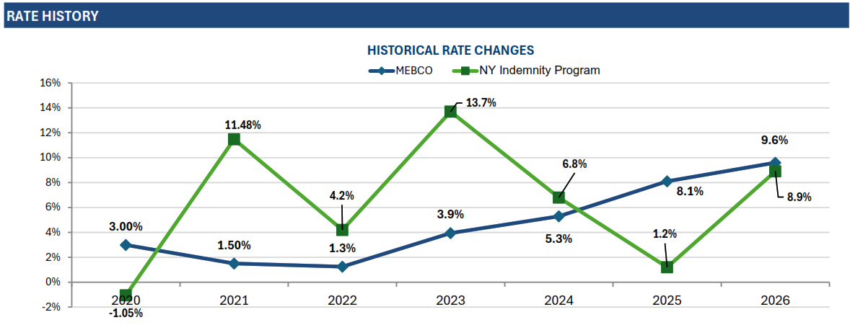
MEBCO: Budget Stability

Slide 13
MEBCO: Cost Savings
Average Single Rate: MEBCO vs. Gov’t Full Indemnity Plan
2020
2021
2022 2023
2024
2025
2026
Average Family Rate: vs. Gov’t Full Indemnity Plan
13
2020
2021
2022 2023
2024
2025
2026

Slide 14

MEBCO: “Forever” Captive
LGC Administrative Core
DE Licensed Special Purpose Captive
Not risk bearing
MEBCORP
Administrative Captive Owner
Captive Service Providers
(captive manager, legal, auditor, actuary, etc.)
Captive Cell #1
Municipal Employees Benefits Consortium “MEBCO” (Group)
Captive Cell #2
Consortium (Group) of Gov’t Entities
forms and joins its own captive cell
Captive Cell #3
Large Gov’t Entity
(Single Parent)
forms and joins its own captive cell

Slide 15
Thank you!
Any questions?

Slide 16

For online courses and webinars in captive insurance, visit the website of the official education program of the captive industry: www.iccie.org

