Slide 1
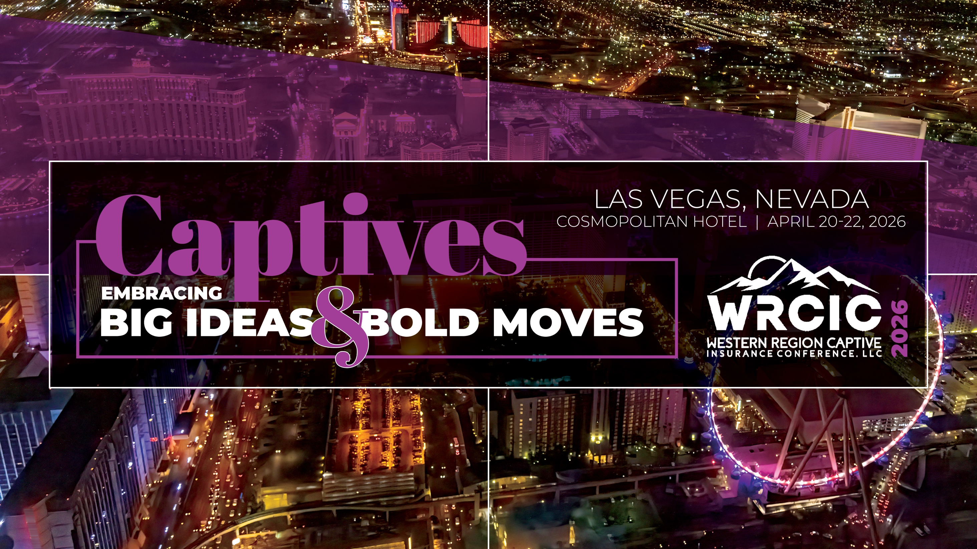

Slide 2
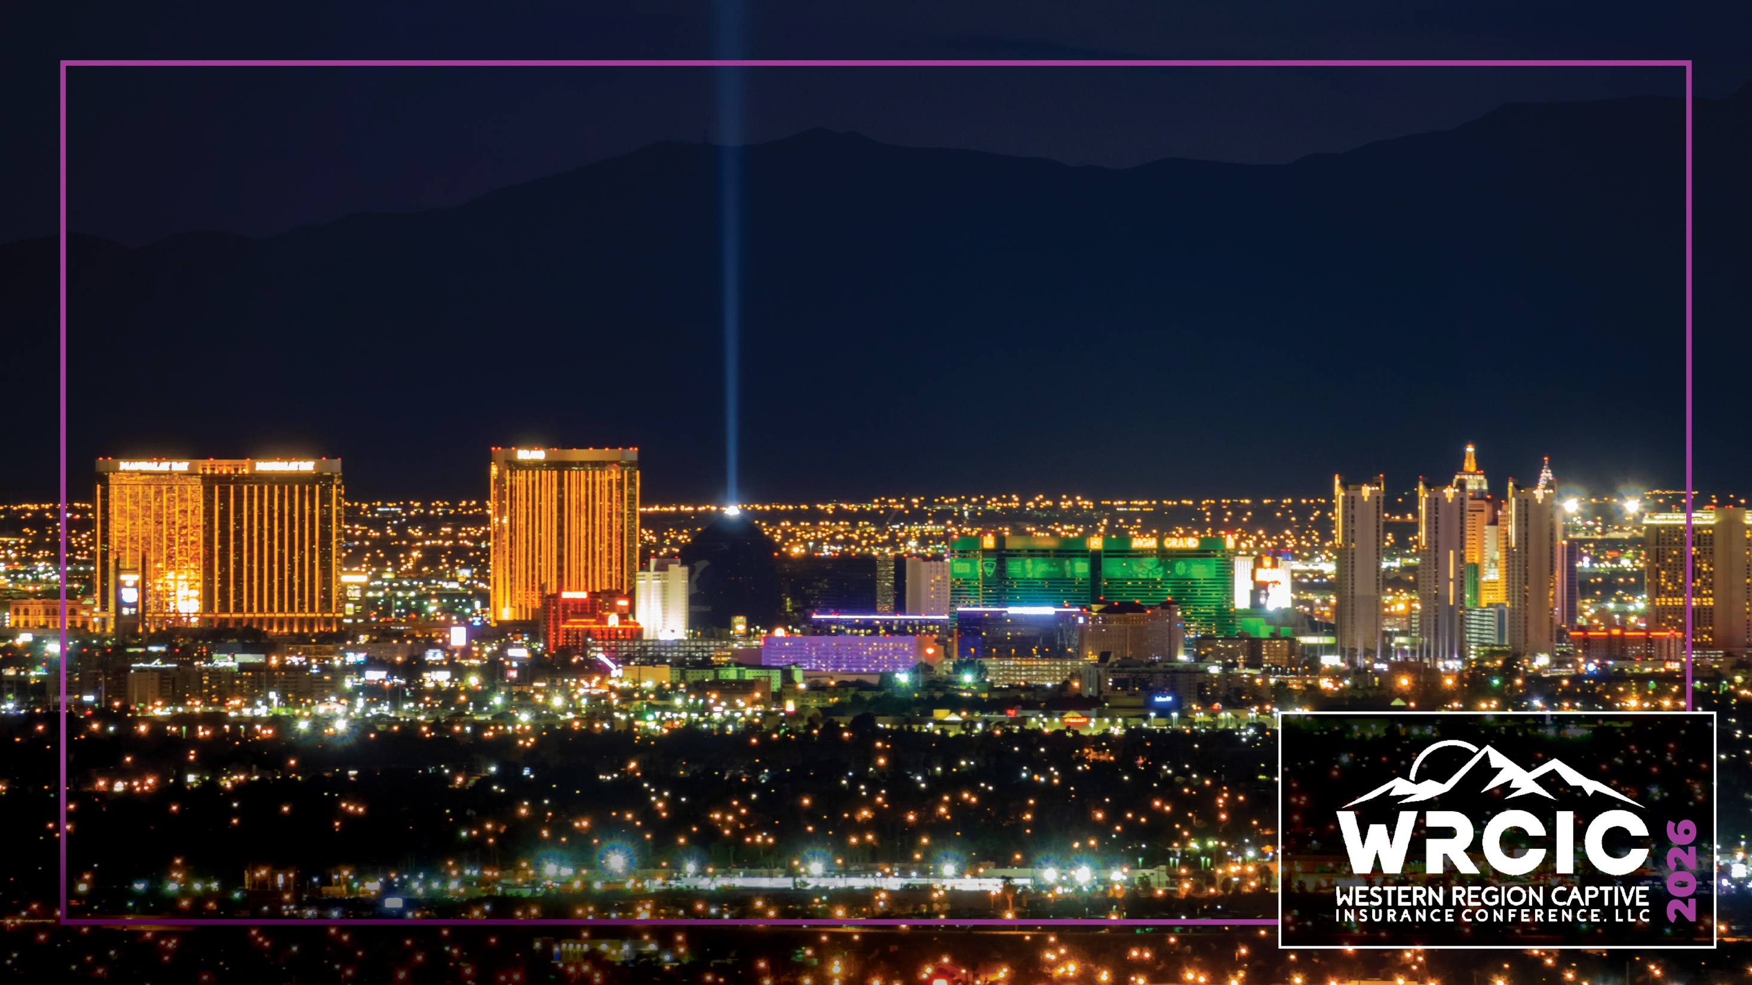
Risk Management in Las Vegas
Mark Habersack
April 21, 2026

Slide 3

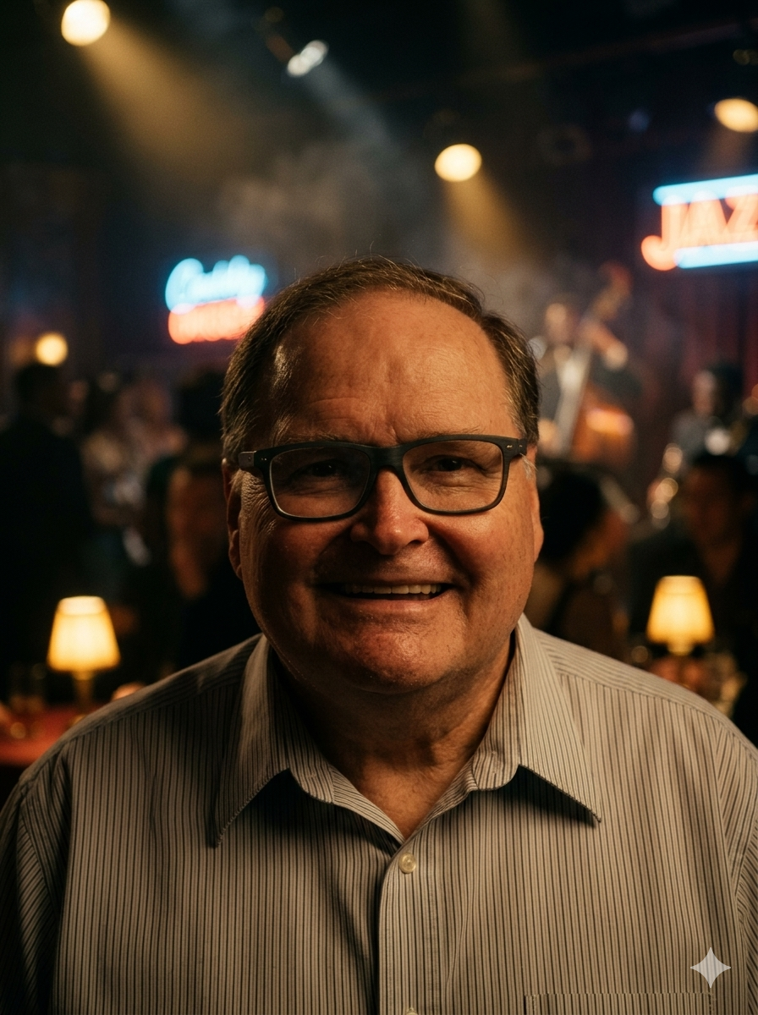
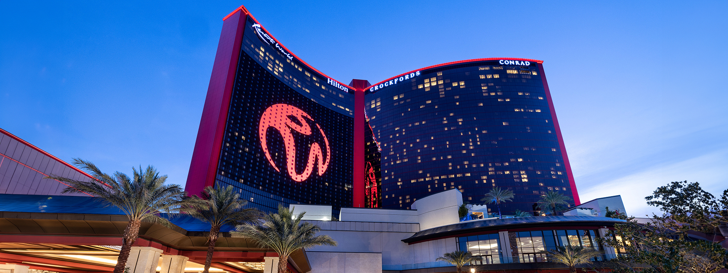
What Keeps Me Awake at Night
Everyday is an adventure

Slide 4

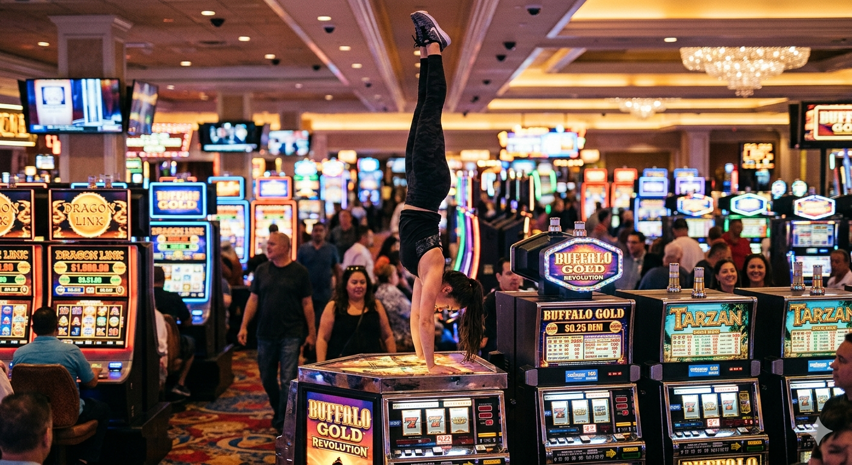
What can go wrong?
Everyday is an adventure:
2:30 AM The phone call from Security
Re: The Slot Machine Acrobat

Slide 5
We are Unlike Any Other Business
A casino floor is a living organism:
Patron safety in a high energy environment
Cash handling and financial controls
Table game and slot integrity
Surveillance and security coordination
Regulatory reporting and compliance
Employee safety in a 24/7 operation
Behavioral unpredictability — alcohol, adrenaline, and money can be an interesting combination

Slide 6

A few realities define my world
Volume is its own risk category
The environment is high energy and high expectation
The risk profile changes by the hour
We operate under intense regulatory scrutiny

Slide 7
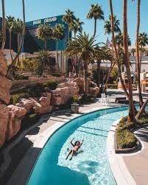
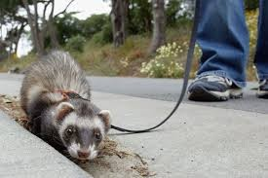
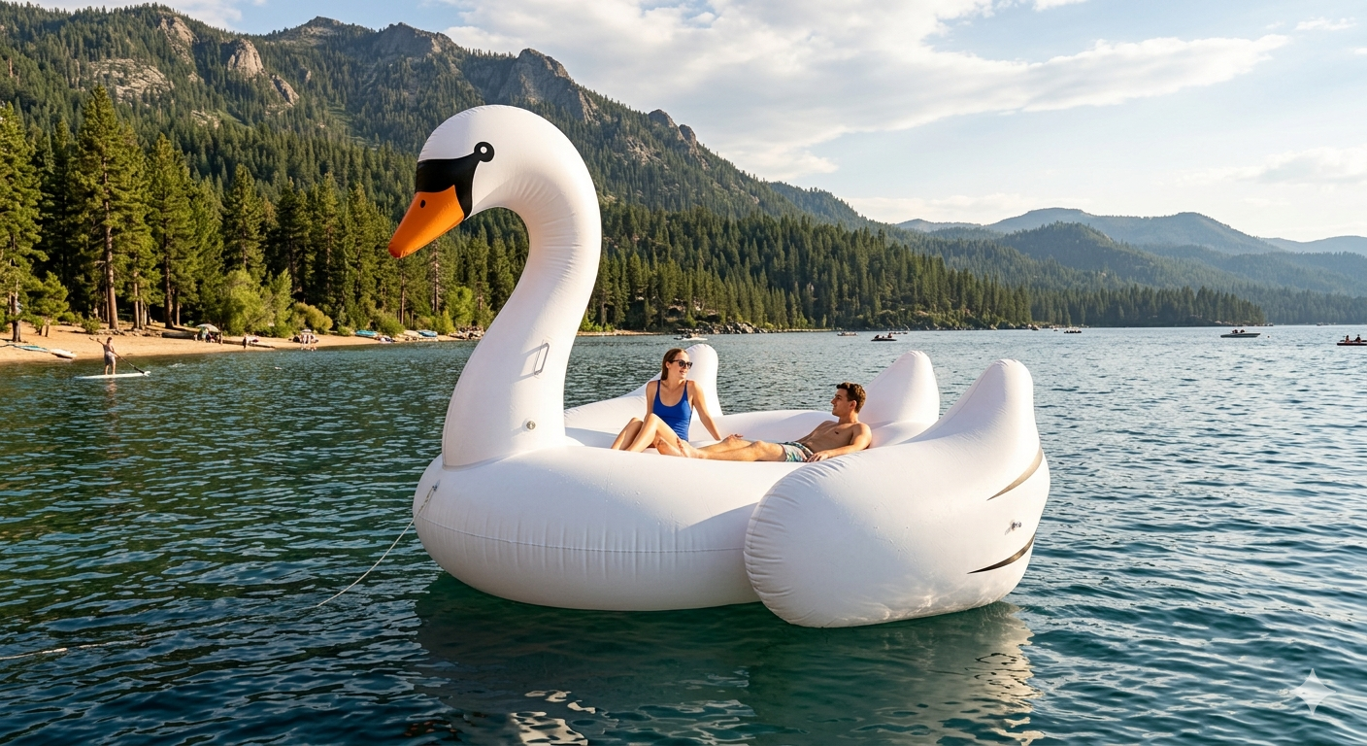
What can go wrong?
There is a Never-Ending Source of Creativity
The Emotional Support… What?
The Pool Deck:
Where Risk Takes a Vacation Too
The Swan Great Escape

Slide 8
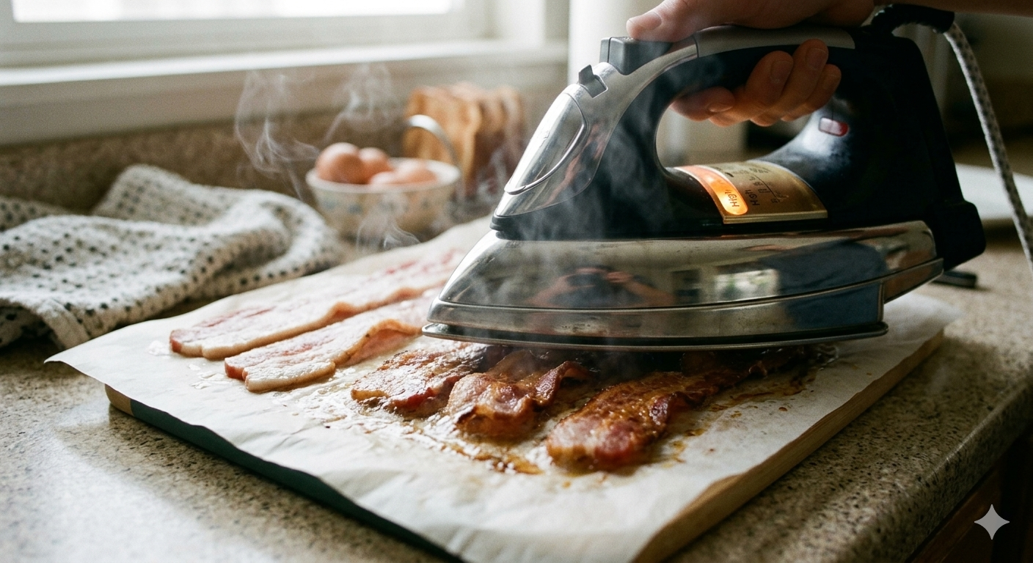
What can go wrong?
The Hotel Tower:
Where People Forget They’re Not at Home
The Improvised Chef

Slide 9
Building a Risk Culture in a Resort the Size of a Small City
Training that’s practical, not theoretical
Partnership with operations
Data driven decision making
Rapid communication loops

Slide 10
Why Captives Matter (Especially Here)?
Captives let us:
Tailor coverage to our actual exposures
Reward strong safety programs
Smooth out volatility
And avoid explaining to an underwriter why someone tried to ride a luggage cart like a skateboard
Captives are the adult supervision in a city that doesn’t always act like an adult.

Slide 11
The Paradox of Las Vegas
Las Vegas is built on risk — but it only works because behind the scenes, thousands of people are working to make sure the fun stays fun and the chaos stays controlled.
At Resorts World, our job is to make sure the magic on the surface is supported by a foundation of safety, compliance, and common sense.

Slide 12
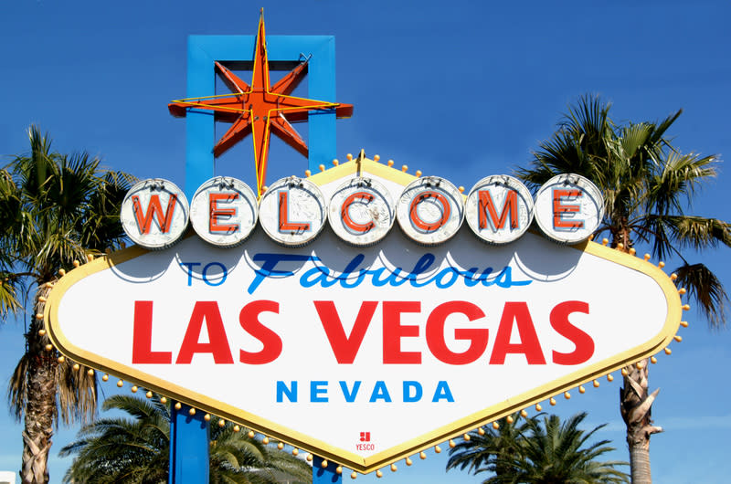
Thank You

