Slide 1


Slide 2
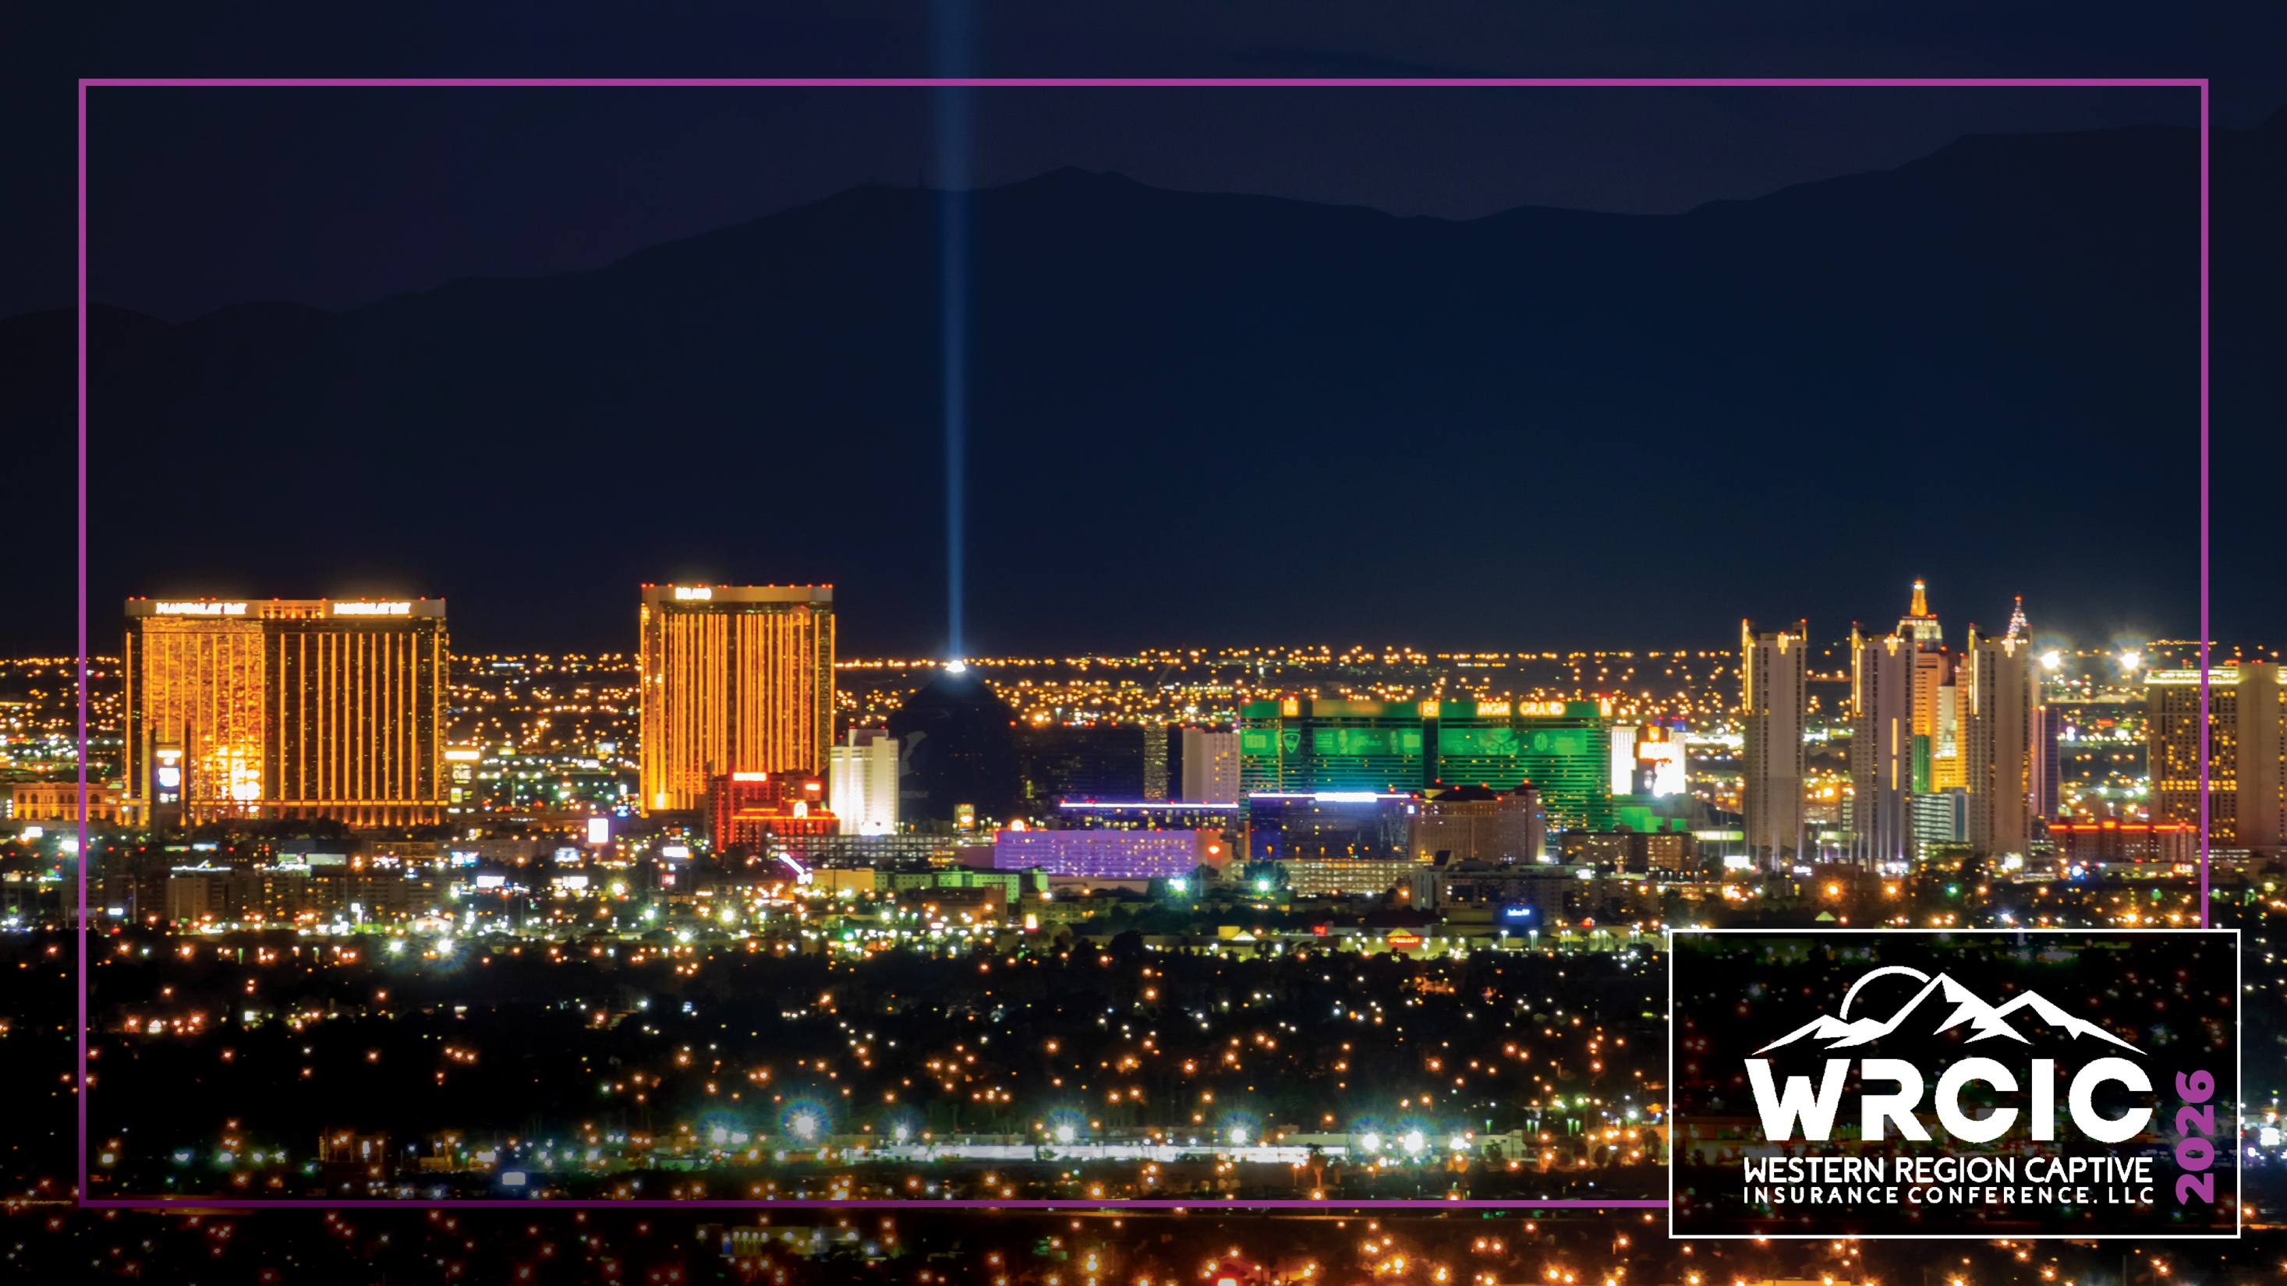
Lawyers, Guns, Drugs,
& Money
Kyle Sweet
Matt Grimes
Martha Hayes
Stephanie Liu
Grace Topete
Date, 2026

Slide 3

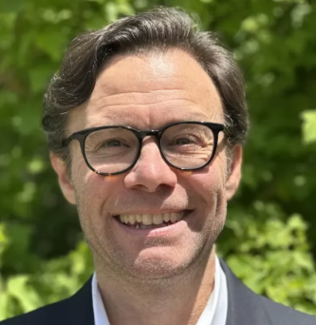
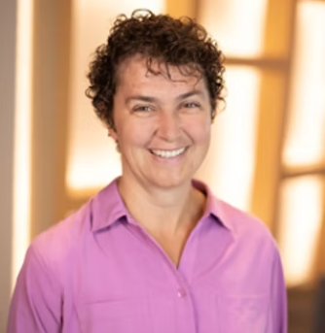
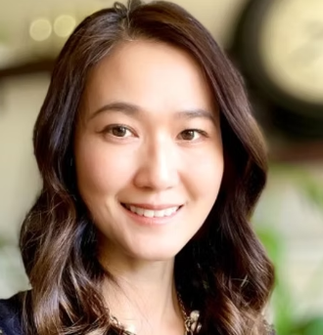
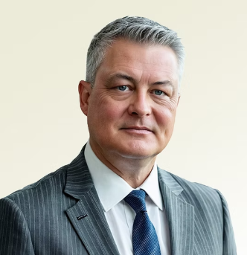
Lawyers, Guns, Drugs, & Money:
How captives are creating stability
in the world’s most controversial industries

Slide 4
Warren Zevon, 1978
Zevon was in Cuba with his manager in a taxi and the driver made a quick stop to pick up the taxi driver’s sister who he said had been kidnapped.
As the kidnappers chased the taxi, Warren’s manager
deadpanned “Call my Dad and tell him to
send some lawyers.” Warren replied,
“Yeah and guns and money too!”
Hank Williams Jr.’s cover with modified lyrics:
“I was gambling in Las Vegas. I took a little risk.
Send lawyers, guns, and money
to get me out of this!”

Slide 5

Starting From Scratch
Identifying unique risks
Assessing market opportunities
Choosing the right captive structure

Slide 6
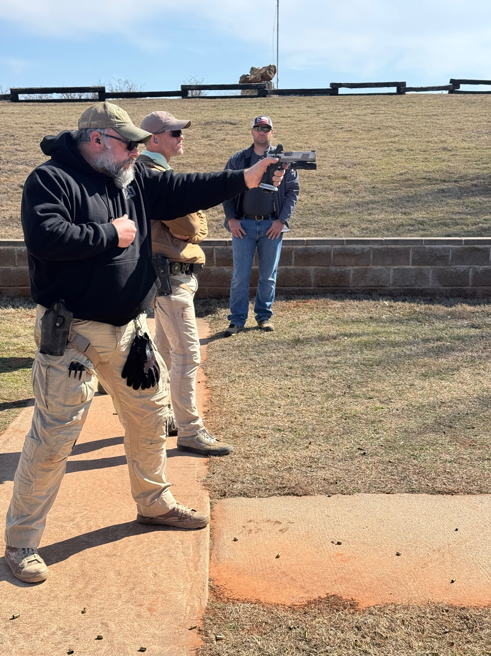
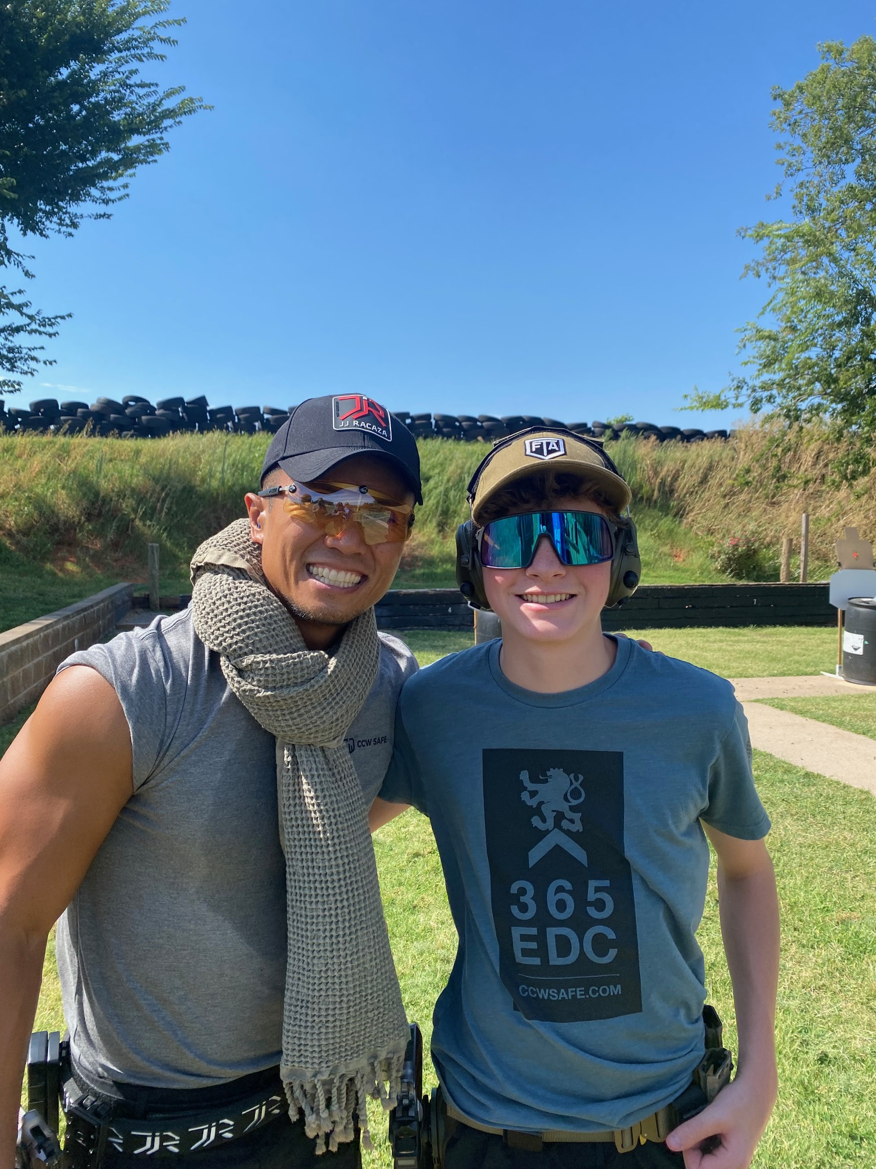
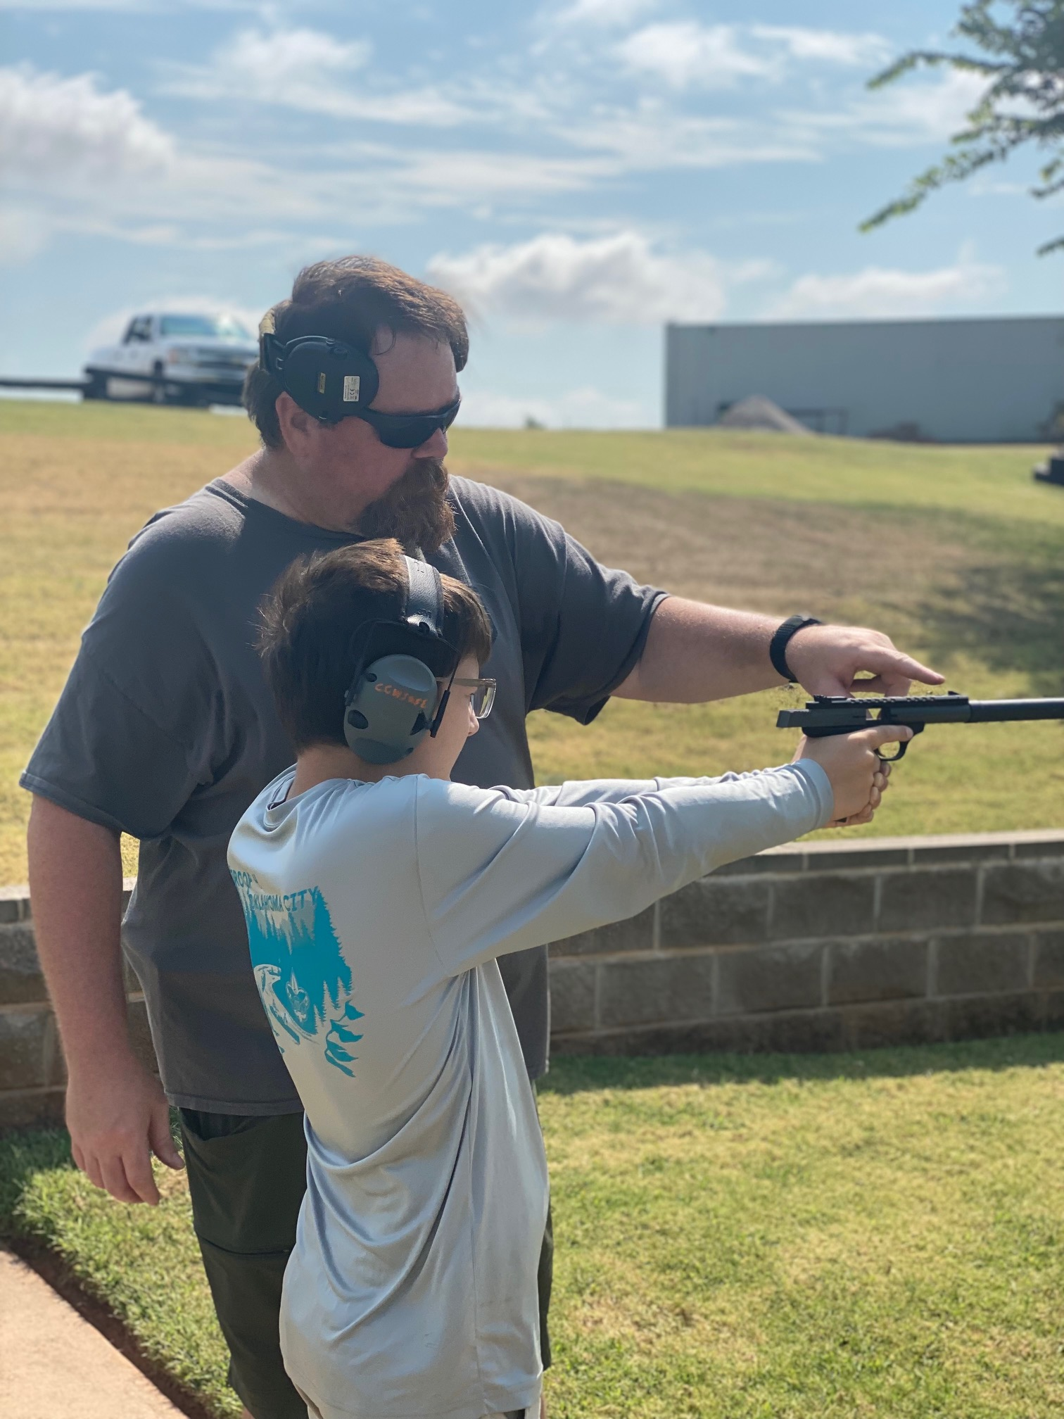
CCW Safe Captive

Slide 7



NPA Captive

Slide 8



Regulatory Review
Assessing unusual risks
Working within legislative frameworks
Networking service providers
Case examples

Slide 9


Building Accountability Through Audit
Assessing financial stability
Affirming ethical standards
Claims handling selection testing
Fraud prevention

Slide 10

Making the World Safer
Creating financial stability for new solutions
Ensuring safety nets in industries perceived as “risky”
Rewarding proactive risk management
Lowering risk thresholds for innovation

Slide 11
Questions & Answers
Thank You!

Slide 12

For online courses and webinars in captive insurance, visit the website of the official education program of the captive industry: www.iccie.org

